Slide 1
Elementary Linear Algebra
Anton & Rorres, 9th Edition
Lecture Set – 06
Chapter 6:
Inner Product Spaces

Slide 2
Chapter Content
Inner Products
Angle and Orthogonality in Inner Product Spaces
Orthonormal Bases; Gram-Schmidt Process; QR-Decomposition
Best Approximation; Least Squares
Orthogonal Matrices; Change of Basis
115/11/08
Elementary Linear Algebra

Slide 3
6-1 Inner Product Space
An inner product on a real vector space V
  a function that associates a real number ⟨u, v⟩ with each pair of vectors u and v in V in such a way that the following axioms are satisfied for all vectors u, v, and w in V and all scalars k.
  ⟨u, v⟩ = ⟨v, u⟩
  ⟨u + v, w⟩ = ⟨u, w⟩ + ⟨v, w⟩
  ⟨ku, v⟩ = k ⟨u, v⟩
  ⟨u, u⟩ ≥ 0 and ⟨u, u⟩ = 0 if and only if u = 0
A real vector space with an inner product is called a real inner product space.
115/11/08
Elementary Linear Algebra

Slide 4
6-1 Example
Euclidean Inner Product on R^{n}
  If u = (u₁, u₂, …, u_{n}) and v = (v₁, v₂, …, v_{n}) are vectors in R^{n}, then the formula
⟨v, u⟩ = u · v = u₁v₁ + u₂v₂ + … + u_{n}v_{n}
defines ⟨v, u⟩ to be the Euclidean product on R^{n}.
The four inner product axioms hold by Theorem 4.1.2.
115/11/08
Elementary Linear Algebra

Slide 5
6-1 Preview of Inner Product
Theorem 4.1.2
  If u, v and w are vectors in R^{n} and k is any scalar, then
    u · v = v · u
    (u + v) · w = u · w + v · w
    (k u) · v = k (u · v)
    v · v ≥ 0; Further, v · v = 0 if and only if v = 0
Example
  (3u + 2v) · (4u + v)
  = (3u) · (4u + v) + (2v) · (4u + v )
  = (3u) · (4u) + (3u) · v + (2v) · (4u) + (2v) · v
  =12(u · u) + 11(u · v) + 2(v · v)
115/11/08
Elementary Linear Algebra

Slide 6
6-1 Weighted Euclidean Inner Product
If w₁, w₂, …, w_{n} are positive real numbers
  We call weights
If u = (u₁, u₂, …, u_{n}) and v = (v₁, v₂, …, v_{n}) are vectors in R^{n}, then the formula
⟨v, u⟩ = u · v = w₁u₁v₁ + w₂u₂v₂ + … + w_{n}u_{n}v_{n}
is called the weighted Euclidean inner product with weights w₁, w₂, …, w_{n}.
115/11/08
Elementary Linear Algebra

Slide 7
6-1 Example 2
Let u = (u₁, u₂) and v = (v₁, v₂) be vectors in R². Verify that the weighted Euclidean inner product ⟨u, v⟩ = 3u₁v₁ + 2u₂v₂ satisfies the four product axioms.
Solution:
  <1> ⟨u, v⟩ = ⟨v, u⟩.
  <2> If w = (w₁, w₂), then ⟨u + v, w⟩ = (3u₁w₁ + 2u₂w₂) + (3v₁w₁ + 2v₂w₂)= ⟨u, w⟩ + ⟨v, w⟩
  <3> ⟨ku, v⟩ =3(ku₁)v₁ + 2(ku₂)v₂ = k(3u₁v₁ + 2u₂v₂) = k ⟨u, v⟩
  <4> ⟨v, v⟩ = 3v₁v₁+2v₂v₂ = 3v₁² + 2v₂² .Obviously , ⟨v, v⟩ = 3v₁² + 2v₂² ≥0 . Furthermore, ⟨v, v⟩ = 3v₁² + 2v₂² = 0 if and only if v₁ = v₂ = 0, That is , if and only if v = (v₁,v₂)=0.
115/11/08
Elementary Linear Algebra

Slide 8
6-1 Norm & Length
If V is an inner product space, then the norm (or length) of a vector u in V is denoted by ||u|| and is defined by
||u|| = ⟨u, u⟩^{½}
The distance between two points (vectors) u and v is denoted by d(u,v) and is defined by
d(u, v) = ||u – v||
115/11/08
Elementary Linear Algebra

Slide 9
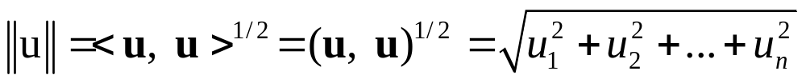
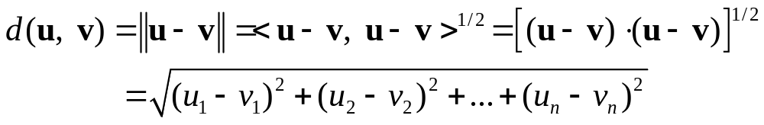
6-1 Example 3
Norm and Distance in R^{n}
  If u = (u₁, u₂, …, u_{n}) and v = (v₁, v₂, …, v_{n}) are vectors in R^{n} with the Euclidean inner product, then
115/11/08
Elementary Linear Algebra

Slide 10
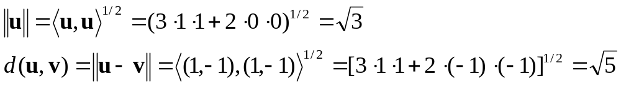
6-1 Example 4
(Weighted Euclidean Inner Product)
The norm and distance depend on the inner product used.
  For example, for the vectors u = (1,0) and v = (0,1) in R² with the Euclidean inner product, we have
  However, if we change to the weighted Euclidean inner product ⟨u, v⟩ = 3u₁v₁ + 2u₂v₂ , then we obtain
115/11/08
Elementary Linear Algebra

Slide 11
6-1 Unit Circles and Spheres in IPS
If V is an inner product space, then the set of points in V that satisfy
||u|| = 1
is called the unite sphere or sometimes the unit circle in V. In R² and R³ these are the points that lie 1 unit away form the origin.
115/11/08
Elementary Linear Algebra

Slide 12
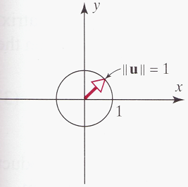
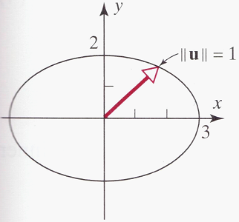
6-1 Example 5 (Unit Circles in R²)
Sketch the unit circle in an xy-coordinate system in R² using the Euclidean inner product ⟨u, v⟩ = u₁v₁ + u₂v₂
Sketch the unit circle in an xy-coordinate system in R² using the Euclidean inner product ⟨u, v⟩ = 1/9u₁v₁ + 1/4u₂v₂
Solution
  If u = (x,y), then ||u|| = ⟨u, u⟩^{½} = (x² + y²)^{½}, so the equation of the unit circle is x² + y² = 1.
  If u = (x,y), then ||u|| = ⟨u, u⟩^{½} = (1/9x² + 1/4y²)^{½}, so the equation of the unit circle is x² /9 + y²/4 = 1.
115/11/08
Elementary Linear Algebra

Slide 13
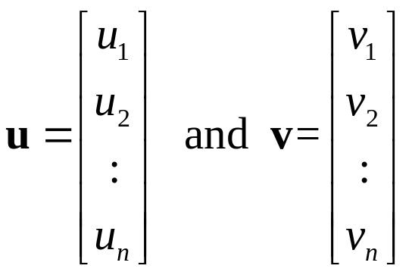
6-1 Inner Product Generated by Matrices
Let be vectors in R^{n} (expressed as n×1
matrices), and let A be an invertible n×n matrix.
If u · v is the Euclidean inner product on R^{n}, then the formula
⟨u, v⟩ = Au · Av
defines an inner product; it is called the inner product on R^{n} generated by A.
The Euclidean inner product u · v can be written as the matrix product v^{T}u, the above formula can be written in the alternative form ⟨u, v⟩ = (Av) ^{T}Au, or equivalently,
⟨u, v⟩ = v^{T}A^{T}Au
115/11/08
Elementary Linear Algebra

Slide 14
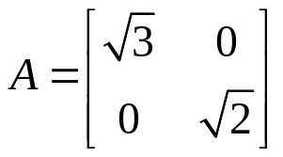
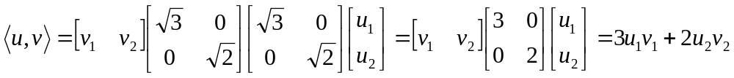

6-1 Example 6
(Inner Product Generated by the Identity Matrix)
The inner product on R^{n} generated by the n×n identity matrix is the Euclidean inner product: Let A = I, we have ⟨u, v⟩ = Iu · Iv = u · v
The weighted Euclidean inner product ⟨u, v⟩ = 3u₁v₁ + 2u₂v₂ is the inner product on R² generated by
since
In general, the weighted Euclidean inner product ⟨u, v⟩ = w₁u₁v₁ + w₂u₂v₂ + … + w_{n}u_{n}v_{n} is the inner product on R^{n} generated by
115/11/08
Elementary Linear Algebra

Slide 15
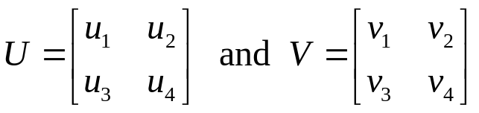
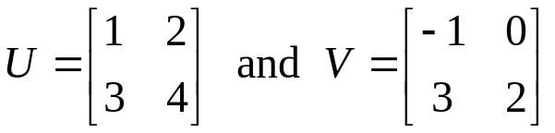

6-1 Example 7 (An Inner Product on M₂₂)
If
are any two 2×2 matrices, then
⟨U, V⟩ = tr(U^{T}V) = tr(V^{T}U) = u₁v₁ + u₂v₂ + u₃v₃ + u₄v₄
defines an inner product on M₂₂
For example, if
then ⟨U, V⟩ = 16
The norm of a matrix U relative to this inner product is
and the unit sphere in this space consists of all 2×2 matrices U whose entries satisfy the equation ||U|| = 1, which on squaring yields u₁² + u₂² + u₃² + u₄² = 1
115/11/08
Elementary Linear Algebra

Slide 16
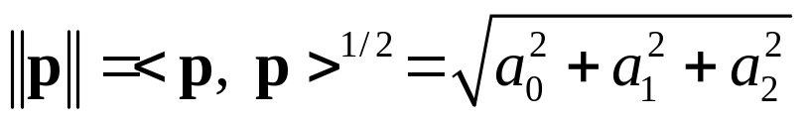
6-1 Example 8 (An Inner Product on P₂)
If p = a₀ + a₁x + a₂x² and q = b₀ + b₁x + b₂x² are any two vectors in P₂,
  An inner product on P₂:
⟨p, q⟩ = a₀b₀ + a₁b₁ + a₂b₂
The norm of the polynomial p relative to this inner product is
The unit sphere in this space consists of all polynomials p in P₂ whose coefficients satisfy the equation || p || = 1, which on squaring yields
a₀²+ a₁² + a₂² =1
115/11/08
Elementary Linear Algebra

Slide 17
Theorem 6.1.1
(Properties of Inner Products)
If u, v, and w are vectors in a real inner product space, and k is any scalar, then:
  ⟨0, v⟩ = ⟨v, 0⟩ = 0
  ⟨u, v + w⟩ = ⟨u, v⟩ + ⟨u, w⟩
  ⟨u, kv⟩ =k ⟨u, v⟩
  ⟨u – v, w⟩ = ⟨u, w⟩ – ⟨v, w⟩
  ⟨u, v – w⟩ = ⟨u, v⟩ – ⟨u, w⟩
115/11/08
Elementary Linear Algebra

Slide 18
6-1 Example 11
⟨u – 2v, 3u + 4v⟩
= ⟨u, 3u + 4v⟩ – ⟨ 2v, 3u+4v⟩
= ⟨u, 3u⟩ + ⟨u, 4v⟩ – ⟨2v, 3u⟩ – ⟨2v, 4v⟩
= 3 ⟨u, u⟩ + 4 ⟨u, v⟩ – 6 ⟨v, u⟩ – 8 ⟨v, v⟩
= 3 || u ||² + 4 ⟨u, v⟩ – 6 ⟨u, v⟩ – 8 || v ||²
= 3 || u ||² – 2 ⟨u, v⟩ – 8 || v ||²
115/11/08
Elementary Linear Algebra

Slide 19
Chapter Content
Inner Products
Angle and Orthogonality in Inner Product Spaces
Orthonormal Bases; Gram-Schmidt Process; QR-Decomposition
Best Approximation; Least Squares
Orthogonal Matrices; Change of Basis
115/11/08
Elementary Linear Algebra

Slide 20
Theorems 6.2.1 & 6.2.2
Theorem 6.2.1 (Cauchy-Schwarz Inequality)
  If u and v are vectors in a real inner product space, then
  |⟨u, v⟩| ≤ ||u|| ||v||
Theorem 6.2.2 (Properties of Length)
  If u and v are vectors in an inner product space V, and if k is any scalar, then :
    || u || ≥ 0
    || u || = 0 if and only if u = 0
    || ku || = | k | || u ||
    || u + v || ≤ || u || + || v || (Triangle inequality)
115/11/08
Elementary Linear Algebra

Slide 21
Theorem 6.2.3 (Properties of Distance)
If u, v, and w are vectors in an inner product space V, and if k is any scalar, then:
  d(u, v) ≥ 0
  d(u, v) = 0 if and only if u = v
  d(u, v) = d(v, u)
  d(u, v) ≤ d(u, w) + d(w, v) (Triangle inequality)
115/11/08
Elementary Linear Algebra

Slide 22
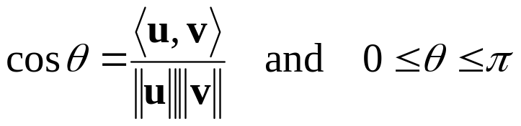
6-2 Angle Between Vectors
The Cauchy-Schwarz inequality for R^{n} (Theorem 4.1.3) follows as a special case of Theorem 6.2.1 by taking ⟨u, v⟩ to be the Euclidean inner product u · v.
The angle between vectors in general inner product spaces can be defined as
Example 2
  Let R⁴ have the Euclidean inner product. Find the cosine of the angle θ between the vectors u = (4, 3, 1, -2) and v = (-2, 1, 2, 3).
115/11/08
Elementary Linear Algebra

Slide 23
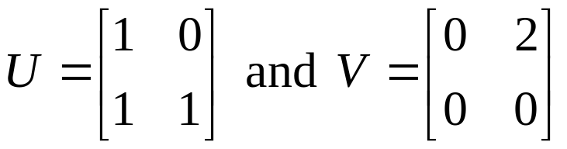
6-2 Orthogonality
Two vectors u and v in an inner product space are called orthogonal if ⟨u, v⟩ = 0.
Example 3
  If M₂₂ has the inner project defined previously, then the matrices
  are orthogonal, since ⟨U, V⟩ = 1(0) + 0(2) + 1(0) + 1(0) = 0.
115/11/08
Elementary Linear Algebra

Slide 24
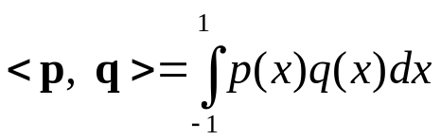
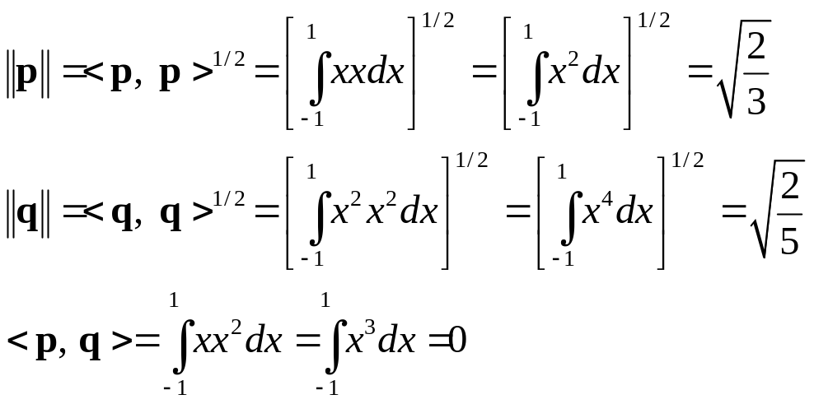
6-2 Example 4 (Orthogonal Vectors in P₂)
Let P₂ have the inner product and let p = x and q = x².
Then
because ⟨p, q⟩ = 0, the vectors p = x and q = x ² are orthogonal relative to the given inner product.
115/11/08
Elementary Linear Algebra

Slide 25
Theorem 6.2.4
(Generalized Theorem of Pythagoras)
If u and v are orthogonal vectors in an inner product space, then
|| u + v ||² = || u ||² + || v ||²
115/11/08
Elementary Linear Algebra

Slide 26
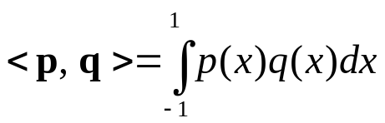
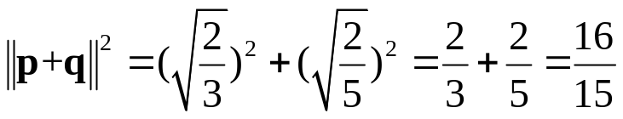
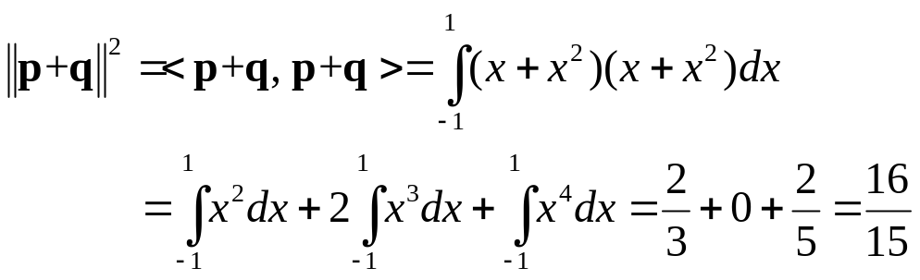
6-2 Example 5
Since p = x and q = x ² are orthogonal relative to the inner product
on P₂.
It follows from the Theorem of Pythagoras that
|| p + q ||² = || p ||² + || q ||²
Thus, from the previous example:
We can check this result by direct integration:
115/11/08
Elementary Linear Algebra

Slide 27
6-2 Orthogonality
Let W be a subspace of an inner product space V.
  A vector u in V is said to be orthogonal to W if it is orthogonal to every vector in W, and
  the set of all vectors in V that are orthogonal to W is called the orthogonal complement of W.
115/11/08
Elementary Linear Algebra

Slide 28
Theorem 6.2.5
(Properties of Orthogonal Complements)
If W is a subspace of a finite-dimensional inner product space V, then:
  W⊥ is a subspace of V.
  The only vector common to W and W⊥ is 0; that is ,W ∩ W⊥ = 0.
  The orthogonal complement of W⊥ is W; that is , (W⊥)⊥ = W.
115/11/08
Elementary Linear Algebra

Slide 29
Theorem 6.2.6
If A is an m×n matrix, then:
  The nullspace of A and the row space of A are orthogonal complements in R^{n} with respect to the Euclidean inner product.
  The nullspace of A^{T} and the column space of A are orthogonal complements in R^{m} with respect to the Euclidean inner product.
115/11/08
Elementary Linear Algebra

Slide 30
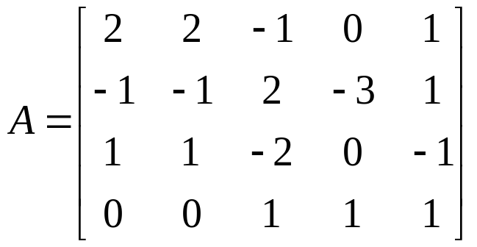
6-2 Example 6
(Basis for an Orthogonal Complement)
Let W be the subspace of R⁵ spanned by the vectors w₁=(2, 2, -1, 0, 1), w₂=(-1, -1, 2, -3, 1), w₃=(1, 1, -2, 0, -1), w₄=(0, 0, 1, 1, 1). Find a basis for the orthogonal complement of W.
Solution
  The space W spanned by w₁, w₂, w₃, and w₄ is the same as the row space of the matrix
115/11/08
Elementary Linear Algebra

Slide 31
Theorem 6.2.7 (Equivalent Statements)
If A is an m×n matrix, and if T_{A} : R^{n} → R^{n} is multiplication by A, then the following are equivalent:
  A is invertible.
  Ax = 0 has only the trivial solution.
  The reduced row-echelon form of A is I_{n}.
  A is expressible as a product of elementary matrices.
  Ax = b is consistent for every n×1 matrix b.
  Ax = b has exactly one solution for every n×1 matrix b.
  det(A)≠0.
  The range of T_{A} is R^{n}.
  T_{A} is one-to-one.
  The column vectors of A are linearly independent.
  The row vectors of A are linearly independent.
  The column vectors of A span R^{n}.
  The row vectors of A span R^{n}.
  The column vectors of A form a basis for R^{n}.
  The row vectors of A form a basis for R^{n}.
  A has rank n.
  A has nullity 0.
  The orthogonal complement of the nullspace of A is R^{n}.
  The orthogonal complement of the row of A is {0}.
115/11/08
Elementary Linear Algebra

Slide 32
Chapter Content
Inner Products
Angle and Orthogonality in Inner Product Spaces
Orthonormal Bases; Gram-Schmidt Process; QR-Decomposition
Best Approximation; Least Squares
Change of Basis
Orthogonal Matrices
115/11/08
Elementary Linear Algebra

Slide 33
6-3 Orthonormal Basis
A set of vectors in an inner product space is called an orthogonal set if all pairs of distinct vectors in the set are orthogonal.
An orthogonal set in which each vector has norm 1 is called orthonormal.
Example 1
  Let u₁ = (0, 1, 0), u₂ = (1, 0, 1), u₃ = (1, 0, -1) and assume that R³ has the Euclidean inner product.
  It follows that the set of vectors S = {u₁, u₂, u₃} is orthogonal since
  ⟨u₁, u₂⟩ = ⟨u₁, u₃⟩ = ⟨u₂, u₃⟩ = 0.
115/11/08
Elementary Linear Algebra

Slide 34
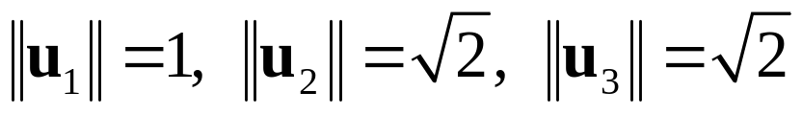
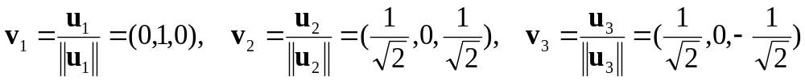
6-3 Example 2
Let u₁ = (0, 1, 0), u₂ = (1, 0, 1), u₃ = (1, 0, -1)
  The Euclidean norms of the vectors are
  Normalizing u₁, u₂, and u₃ yields
  The set S = {v₁, v₂, v₃} is orthonormal since
  ⟨v₁, v₂⟩ = ⟨v₁, v₃⟩ = ⟨v₂, v₃⟩ = 0 and ||v₁|| = ||v₂|| = ||v₃|| = 1
115/11/08
Elementary Linear Algebra

Slide 35
6-3 Orthonormal Basis
Theorem 6.3.1*
  If S = {v₁, v₂, …, v_{n}} is an orthonormal basis for an inner product space V, and u is any vector in V, then
  u = ⟨u, v₁⟩ v₁ + ⟨u, v₂⟩ v₂ + · · · + ⟨u, v_{n}⟩ v_{n}
Remark
  The scalars ⟨u, v₁⟩, ⟨u, v₂⟩, … , ⟨u, v_{n}⟩ are the coordinates of the vector u relative to the orthonormal basis S = {v₁, v₂, …, v_{n}} and
  (u)_{S} = (⟨u, v₁⟩, ⟨u, v₂⟩, … , ⟨u, v_{n}⟩)
  is the coordinate vector of u relative to this basis
115/11/08
Elementary Linear Algebra

Slide 36
6-3 Example 3
Let v₁ = (0, 1, 0), v₂ = (-4/5, 0, 3/5), v₃ = (3/5, 0, 4/5).
It is easy to check that S = {v₁, v₂, v₃} is an orthonormal basis for R³ with the Euclidean inner product.
Express the vector u = (1, 1, 1) as a linear combination of the vectors in S, and find the coordinate vector (u)_{s}.
Solution:
  ⟨u, v₁⟩ = 1, ⟨u, v₂⟩ = -1/5, ⟨u, v₃⟩ = 7/5
  Therefore, by Theorem 6.3.1 we have u = v₁ – 1/5 v₂ + 7/5 v₃
  That is, (1, 1, 1) = (0, 1, 0) – 1/5 (-4/5, 0, 3/5) + 7/5 (3/5, 0, 4/5)
  The coordinate vector of u relative to S is
  (u)_{s}=(⟨u, v₁⟩, ⟨u, v₂⟩, ⟨u, v₃⟩) = (1, -1/5, 7/5)
115/11/08
Elementary Linear Algebra

Slide 37
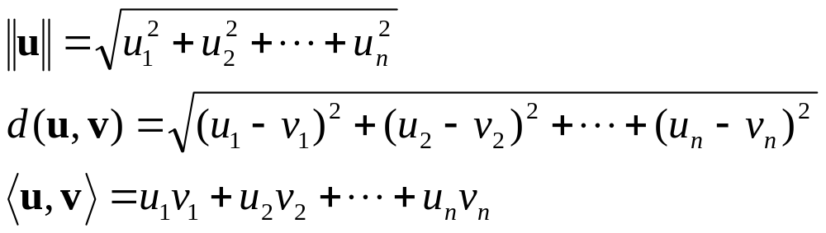
Theorem 6.3.2
If S is an orthonormal basis for an n-dimensional inner product space, and if (u)_{s} = (u₁, u₂, …, u_{n}) and (v)_{s} = (v₁, v₂, …, v_{n}) then:
Example 4 (Calculating Norms Using Orthonormal Bases)
  u=(1, 1, 1)
115/11/08
Elementary Linear Algebra

Slide 38
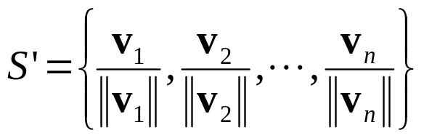
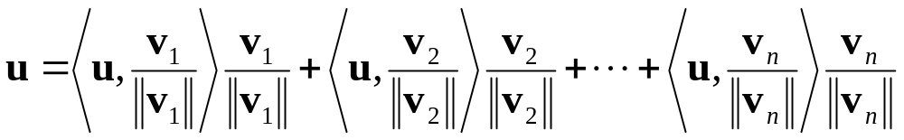
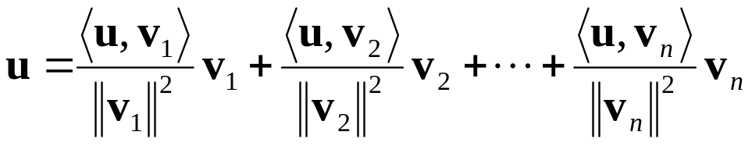
6-3 Coordinates Relative to Orthogonal Bases
If S = {v₁, v₂, …, v_{n}} is an orthogonal basis for a vector space V, then normalizing each of these vectors yields the orthonormal basis
Thus, if u is any vector in V, it follows from theorem 6.3.1 that
or
The above equation expresses u as a linear combination of the vectors in the orthogonal basis S.
115/11/08
Elementary Linear Algebra

Slide 39
Theorem 6.3.3
If S = {v₁, v₂, …, v_{n}} is an orthogonal set of nonzero vectors in an inner product space
  then S is linearly independent.
Remark
  By working with orthonormal bases, the computation of general norms and inner products can be reduced to the computation of Euclidean norms and inner products of the coordinate vectors.
115/11/08
Elementary Linear Algebra

Slide 40
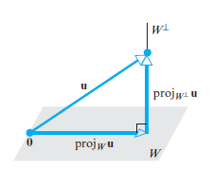
Theorem 6.3.4 (Projection Theorem)
If W is a finite-dimensional subspace of an product space V,
  then every vector u in V can be expressed in exactly one way as
  u = w₁ + w₂
  where w₁ is in W and w₂ is in W⊥.
115/11/08
Elementary Linear Algebra

Slide 41
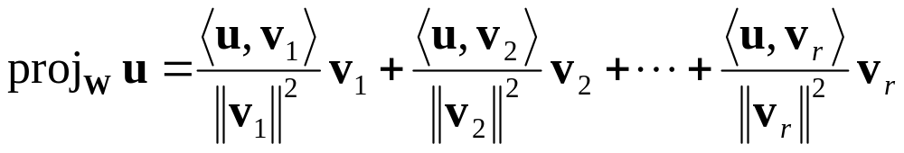
Theorem 6.3.5
Let W be a finite-dimensional subspace of an inner product space V.
  If {v₁, …, v_{r}} is an orthonormal basis for W, and u is any vector in V, then
    proj_{w}u = ⟨u,v₁⟩ v₁ + ⟨u,v₂⟩ v₂ + … + ⟨u,v_{r}⟩ v_{r}
  If {v₁, …, v_{r}} is an orthogonal basis for W, and u is any vector in V, then
Need Normalization
115/11/08
Elementary Linear Algebra

Slide 42
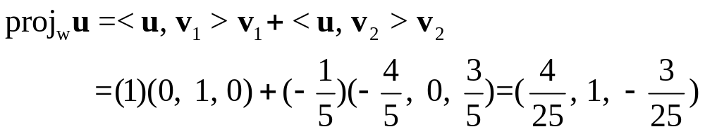
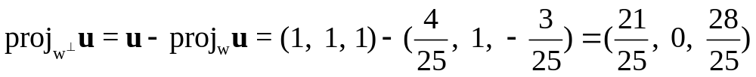
6-3 Example 6
Let R³ have the Euclidean inner product, and let W be the subspace spanned by the orthonormal vectors v₁ = (0, 1, 0) and v₂ = (-4/5, 0, 3/5).
From the above theorem, the orthogonal projection of u = (1, 1, 1) on W is
The component of u orthogonal to W is
Observe that proj_{W}⊥u is orthogonal to both v₁ and v₂.
115/11/08
Elementary Linear Algebra

Slide 43
6-3 Finding Orthogonal/Orthonormal Bases
Theorem 6.3.6
  Every nonzero finite-dimensional inner product space has an orthonormal basis.
Remark
  The step-by-step construction for converting an arbitrary basis into an orthogonal basis is called the Gram-Schmidt process.
115/11/08
Elementary Linear Algebra

Slide 44
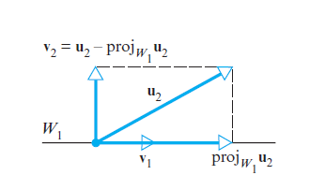
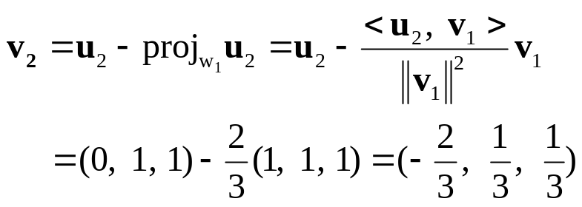
6-3 Example 7(Gram-Schmidt Process)
Consider the vector space R³ with the Euclidean inner product. Apply the Gram-Schmidt process to transform the basis vectors
u₁ = (1, 1, 1), u₂ = (0, 1, 1), u₃ = (0, 0, 1)
into an orthogonal basis {v₁, v₂, v₃}; then normalize the orthogonal basis vectors to obtain an orthonormal basis {q₁, q₂, q₃}.
Solution:
  Step 1: Let v₁ = u₁.That is, v₁ = u₁ = (1, 1, 1)
  Step 2: Let v₂ = u₂ – proj_{W1}u₂. That is,
115/11/08
Elementary Linear Algebra

Slide 45
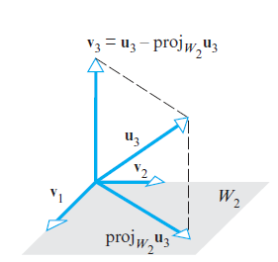

115/11/08
Elementary Linear Algebra

Slide 46
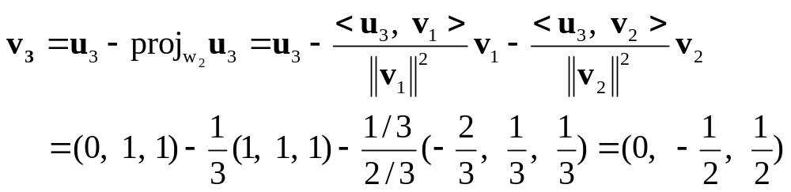
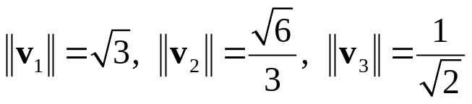
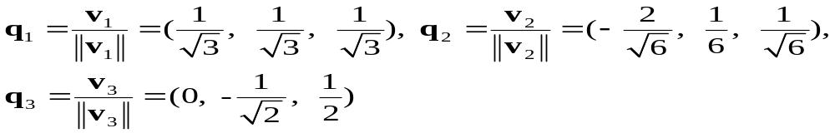
6-3 Example 7(Gram-Schmidt Process)
We have two vectors in W₂ now!
  Step 3: Let v₃ = u₃ – proj_{W2}u₃. That is,
  Thus, v₁ = (1, 1, 1), v₂ = (-2/3, 1/3, 1/3), v₃ = (0, -1/2, 1/2) form an orthogonal basis for R³. The norms of these vectors are
  so an orthonormal basis for R³ is
115/11/08
Elementary Linear Algebra

Slide 47
Theorem 6.3.7 (QR-Decomposition)
If A is an m×n matrix with linearly independent column vectors, then A can be factored as
  A = QR
  where Q is an m×n matrix with orthonormal column vectors, and R is an n×n invertible upper triangular matrix.
115/11/08
Elementary Linear Algebra

Slide 48
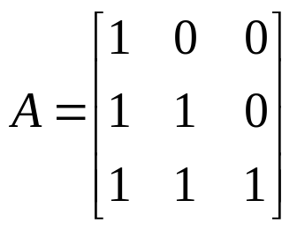
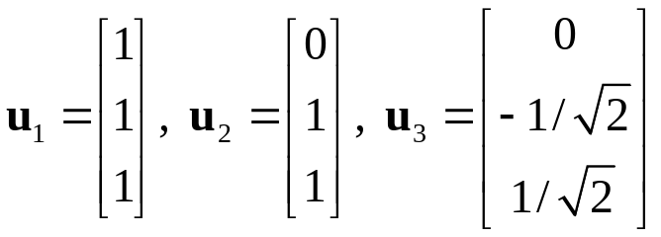
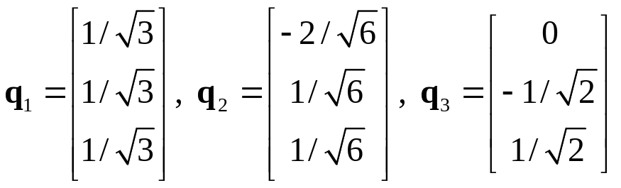
6-3 Example 8
(QR-Decomposition of a 3×3 Matrix)
Find the QR-decomposition of
Solution:
  The column vectors A are
  Applying the Gram-Schmidt process with subsequent normalization to these column vectors yields the orthonormal vectors
Q
115/11/08
Elementary Linear Algebra

Slide 49
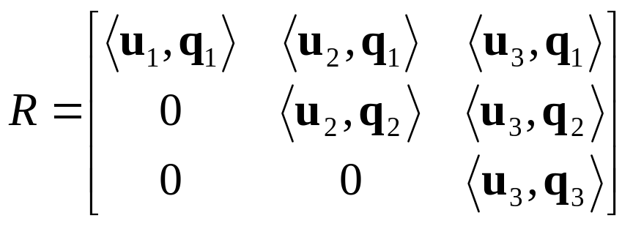
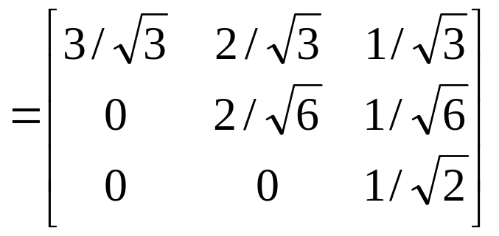
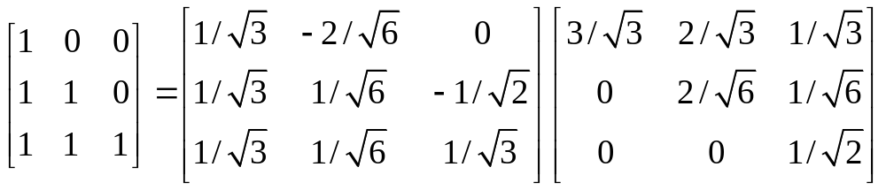
6-3 Example 8
  The matrix R is
  Thus, the QR-decomposition of A is
A
Q
R
115/11/08
Elementary Linear Algebra

Slide 50
Chapter Content
Inner Products
Angle and Orthogonality in Inner Product Spaces
Orthonormal Bases; Gram-Schmidt Process; QR-Decomposition
Best Approximation; Least Squares
Change of Basis
Orthogonal Matrices
115/11/08
Elementary Linear Algebra

Slide 51
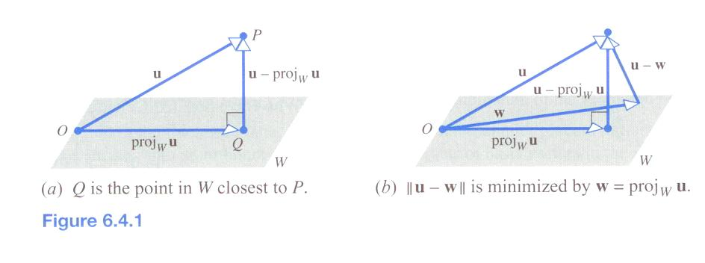
6-4 Orthogonal Projections Viewed as Approximations
If P is a point in 3-space and W is a plane through the origin, then the point Q in W closest to P is obtained by dropping a perpendicular from P to W.
If we let u = OP, the distance between P and W is given by || u – proj_{W}u ||.
In other words, among all vectors w in W the vector w = proj_{W}u
minimize the distance || v – w ||.
115/11/08
Elementary Linear Algebra

Slide 52
6-4 Best Approximation
Remark
  Suppose u is a vector that we would like to approximate by a vector in W.
  Any approximation w will result in an “error vector” u – w which, unless u is in W, cannot be made equal to 0.
  However, by choosing w = proj_{W}u we can make the length of the error vector
  || u – w || = || u – proj_{W}u || as small as possible.
  Thus, we can describe proj_{W}u as the “best approximation” to u by the vectors in W.
115/11/08
Elementary Linear Algebra

Slide 53
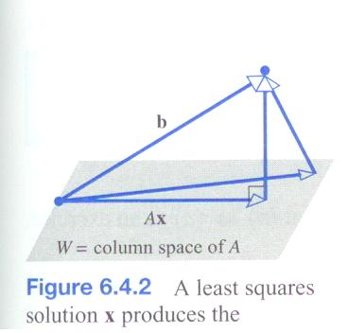
Theorem 6.4.1
(Best Approximation Theorem)
If W is a finite-dimensional subspace of an inner product space V, and if u is a vector in V,
  then proj_{W}u is the best approximation to u form W in the sense that
  || u – proj_{W}u || ＜ || u – w ||
  for every vector w in W that is different from proj_{W}u.
115/11/08
Elementary Linear Algebra

Slide 54
6-4 Least Square Problem
Given a linear system Ax = b of m equations in n unknowns
  find a vector x, if possible, that minimize || Ax – b || with respect to the Euclidean inner product on R^{m}.
  Such a vector is called a least squares solution of Ax = b.
115/11/08
Elementary Linear Algebra

Slide 55
Theorem 6.4.2
For any linear system Ax = b, the associated normal system
  A^{T}Ax = A^{T}b
  is consistent, and all solutions of the normal system are least squares solutions of Ax = b.
  Moreover, if W is the column space of A, and x is any least squares solution of Ax = b, then the orthogonal projection of b on W is
  proj_{W}b = Ax
  (or you can treat it as Ax – proj_{W}b = 0 )
115/11/08
Elementary Linear Algebra

Slide 56
Theorem 6.4.3
If A is an m×n matrix, then the following are equivalent.
  A has linearly independent column vectors.
  A^{T}A is invertible.
115/11/08
Elementary Linear Algebra

Slide 57
Theorem 6.4.4
If A is an m×n matrix with linearly independent column vectors,
  then for every m×1 matrix b, the linear system Ax = b has a unique least squares solution.
  This solution is given by
  x = (A^{T}A)⁻¹A^{T}b
  Moreover, if W is the column space of A, then the orthogonal projection of b on W is
  proj_{W}b = Ax = A(A^{T}A)⁻¹A^{T}b
115/11/08
Elementary Linear Algebra

Slide 58
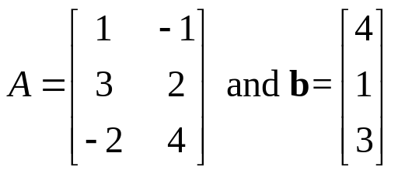
6-4 Example 1 (Least Squares Solution)
Find the least squares solution of the linear system Ax = b given by
x₁ – x₂ = 4
3x₁ + 2x₂ = 1
-2x₁ + 4x₂ = 3
and find the orthogonal projection of b on the column space of A.
Solution:
  Observe that A has linearly independent column vectors, so we know in advance that there is a unique least squares solution.
115/11/08
Elementary Linear Algebra

Slide 59
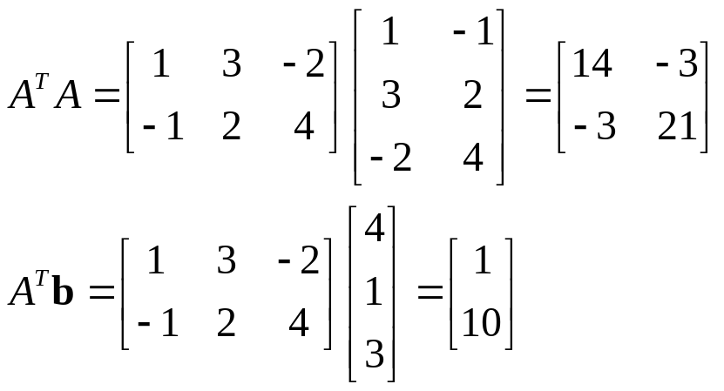
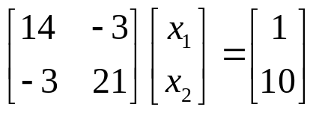
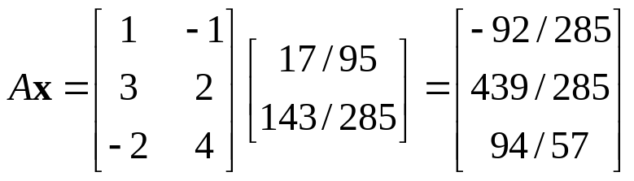
6-4 Example 1
  We have
  so the normal system A^{T}Ax = A^{T}b in this case is
  Solving this system yields the least squares solution
  x₁ = 17/95, x₂ = 143/285
  The orthogonal projection of b on the column space of A is
115/11/08
Elementary Linear Algebra

Slide 60
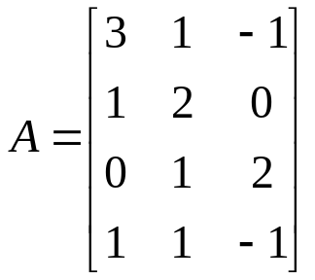
6-4 Example 2
(Orthogonal Projection on a Subspace)
Find the orthogonal projection of the vector u = (-3,-3,8,9) on the subspace of R⁴ spanned by the vectors
u₁ = (3,1,0,1), u₂ = (1,2,1,1), u₃ = (-1,0,2,-1)
Solution:
  The subspace spanned by u₁, u₂, and u₃, is the column space of
  If u is expressed as a column vector, we can find the orthogonal projection of u on W by finding a least squares solution of the system Ax = u.
  proj_{W}u = Ax from the least square solution.
115/11/08
Elementary Linear Algebra

Slide 61
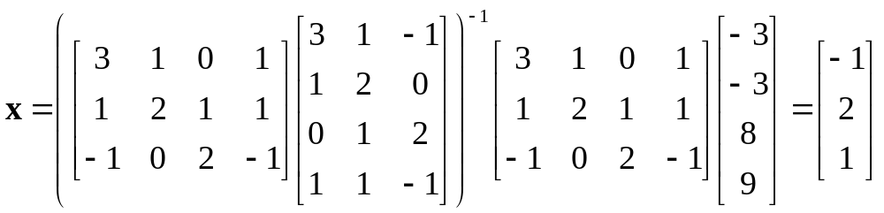
6-4 Example 2
  From Theorem 6.4.4, the least squares solution is given by
  x = (A^{T}A)⁻¹A^{T}u
  That is,
  Thus, proj_{W}u = Ax = [-2 3 4 0]^{T}
  Second method: using Gram-Schmidt process
115/11/08
Elementary Linear Algebra

Slide 62
6-4 Orthogonal Projection
If W is a subspace of R^{m},
  then the transformation P: R^{m} → W that maps each vector x in R^{m} into its orthogonal projection proj_{W}x in W is called orthogonal projection of R^{m} on W.
The orthogonal projections are linear operators
  The standard matrix for the orthogonal projection of R^{m} on W is [P] = A(A^{T}A)⁻¹A^{T}
  where A is constructed using any basis for W as its column vectors
115/11/08
Elementary Linear Algebra

Slide 63
6-4 Example 3
Verifying formula [P] = A(A^{T}A)⁻¹A^{T}
The standard matrix for the orthogonal projection of R3 on the xy-plane :
115/11/08
Elementary Linear Algebra

Slide 64
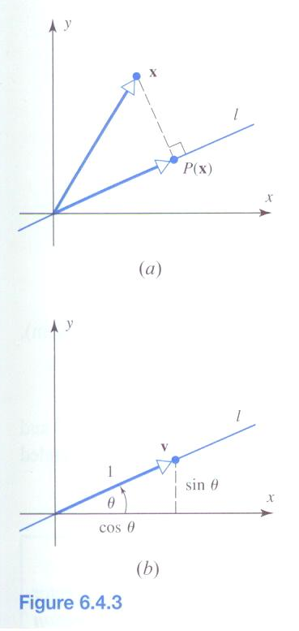

6-4 Example 4
Orthogonal Projection on a Column Space
To apply Formula (11) we must find a matrix A for which the line W is the
column space. Since the line is one-dimensional and consists of all scalar multiples of
the vector w = (cos θ, sin θ)
115/11/08
Elementary Linear Algebra

Slide 65

115/11/08
Elementary Linear Algebra

Slide 66
Theorem 6.4.5 (Equivalent Statements)
If A is an m×n matrix, and if T_{A} : R^{n} → R^{n} is multiplication by A, then the following are equivalent:
  A is invertible.
  Ax = 0 has only the trivial solution.
  The reduced row-echelon form of A is I_{n}.
  A is expressible as a product of elementary matrices.
  Ax = b is consistent for every n×1 matrix b.
  Ax = b has exactly one solution for every n×1 matrix b.
  det(A)≠0.
  The range of T_{A} is R^{n}.
  T_{A} is one-to-one.
  The column vectors of A are linearly independent.
  The row vectors of A are linearly independent.
115/11/08
Elementary Linear Algebra

Slide 67
6-4 Example 4
Find the standard matrix for the orthogonal projection P of R² on the line that passes through the origin and makes an angle θ with the positive x-axis.
115/11/08
Elementary Linear Algebra

Slide 68
Theorem 6.4.5 (Equivalent Statements)
  The column vectors of A span R^{n}.
  The row vectors of A span R^{n}.
  The column vectors of A form a basis for R^{n}.
  The row vectors of A form a basis for R^{n}.
  A has rank n.
  A has nullity 0.
  The orthogonal complement of the nullspace of A is R^{n}.
  The orthogonal complement of the row space of A is {0}.
  A^{T}A is invertible.
115/11/08
Elementary Linear Algebra

Slide 69

6-4 Coordinate Matrices
Recall from Theorem 5.4.1 that if S = {v₁, v₂, …, v_{n}} is a basis for a vector space V, then each vector v in V can be expressed uniquely as a linear combination of the basis vectors, say
v = k₁v₁ + k₂v₂ + … + k_{n}v_{n}
The scalars k₁, k₂, …, k_{n} are the coordinates of v relative to S, and the vector
(v)_{S} = (k₁, k₂, …, k_{n})
is the coordinate vector of v relative to S.
Thus, we define
to be the coordinate matrix of v relative to S.
115/11/08
Elementary Linear Algebra

Slide 70
Chapter Content
Inner Products
Angle and Orthogonality in Inner Product Spaces
Orthonormal Bases; Gram-Schmidt Process; QR-Decomposition
Best Approximation; Least Squares
Change of Basis
Orthogonal Matrices
115/11/08
Elementary Linear Algebra

Slide 71
6-5 Change of Basis
Change of basis problem
  change the basis for a vector space V from some old basis B to a new basis B′ [v]_{B} => [v]_{B’} ?
Solution of the change of basis problem
  change the basis for a vector space V from some old basis B = {u₁, u₂, …, u_{n}} to some new basis B′ = {u₁′, u₂′, …, u_{n}′},
  [v]_{B} = P [v]_{B’}
  where the column of P are the coordinate matrices of the new basis vectors relative to the old basis; that is, the column vectors of P are
  [u₁′]_{B}, [u₂′]_{B}, …, [u_{n}′]_{B}
  The matrix P is called the transition matrix form B′ to B; it can be expressed in terms of its column vector as
  P = [[u₁′]_{B} | [u₂′]_{B} | … | [u_{n}′]_{B}]
115/11/08
Elementary Linear Algebra

Slide 72


6-5 Example 1 (Finding a Transition Matrix)
Consider bases B = {u₁, u₂} and B′ = {u₁’, u₂’} for R², where
u₁ = (1, 0), u₂ = (0, 1);
u₁’ = (1, 1), u₂’ = (2, 1).
Find the transition matrix from B′ to B.
Find [v]_{B} if [v]_{B’} = [-3 5]^{T}.
Solution:
  find the coordinate matrices for the new basis vectors u₁’ and u₂’ relative to the old basis B
  By inspection u′₁ = u₁ + u₂ so that
  Thus, the transition matrix from B′ to B is
115/11/08
Elementary Linear Algebra

Slide 73
6-5 Example 1
(A different view point on Example 1)
Consider bases B = {u₁, u₂} and B′ = {u₁’, u₂’} for R², where
u₁ = (1, 0), u₂ = (0, 1);
u₁’ = (1, 1), u₂’ = (2, 1).
Find the transition matrix from B to B′.
115/11/08
Elementary Linear Algebra

Slide 74
Theorem 6.5.1
If P is the transition matrix from a basis B′ to a basis B for a finite-dimensional vector space V, then:
  P is invertible.
  P⁻¹ is the transition matrix from B to B′.
Remark
  If P is the transition matrix from a basis B′ to a basis B, then for every v the following relationships hold:
  [v]_{B} = P [v]_{B’}
  [v]_{B’} = P⁻¹ [v]_{B}
115/11/08
Elementary Linear Algebra

Slide 75
Chapter Content
Inner Products
Angle and Orthogonality in Inner Product Spaces
Orthonormal Bases; Gram-Schmidt Process; QR-Decomposition
Best Approximation; Least Squares
Change of Basis
Orthogonal Matrices
115/11/08
Elementary Linear Algebra

Slide 76
6-6 Orthogonal Matrix
A square matrix A with the property
  A⁻¹ = A^{T}
  is said to be an orthogonal matrix.
Remark
  A square matrix A is orthogonal if and only if AA^{T} = I or A^{T}A = I.
115/11/08
Elementary Linear Algebra

Slide 77



6-6 Example 1 & 2
Example 1
Example 2
    Rotation and reflection matrices is orthogonal.
115/11/08
Elementary Linear Algebra

Slide 78
Theorem 6.6.1
The following are equivalent for an n×n matrix A.
  A is orthogonal.
  The row vectors of A form an orthonormal set in R^{n} with the Euclidean inner product.
  The column vectors of A form an orthonormal set in R^{n} with the Euclidean inner product.
115/11/08
Elementary Linear Algebra

Slide 79
Theorem 6.6.2
The inverse of an orthogonal matrix is orthogonal.
A product of orthogonal matrices is orthogonal.
If A is orthogonal, then det(A) = 1 or det(A) = -1.
115/11/08
Elementary Linear Algebra

Slide 80

6-6 Example 3
The matrix
is orthogonal since its row (and column) vectors form orthonormal sets in R².
We have det(A) = 1.
Interchanging the rows produces an orthogonal matrix for which det(A) = -1.
115/11/08
Elementary Linear Algebra

Slide 81
Theorem 6.6.3
(Orthogonal Matrices as Linear Operators)
If A is an n×n matrix, then the following are equivalent.
  A is orthogonal.
  || Ax || = || x || for all x in R^{n}.
  Ax · Ay = x · y for all x and y in R^{n}.
Remark:
  If T : R^{n} → R^{n} is multiplication by an orthogonal matrix A, then T is called an orthogonal operator on R^{n}.
  It follows from the preceding theorem that the orthogonal operator on R^{n} are precisely those operators that leave the length of all vectors unchanged.
115/11/08
Elementary Linear Algebra

Slide 82
Theorem 6.6.4
If P is the transition matrix from one orthonormal basis to another orthonormal basis for an inner product space,
  then P is an orthogonal matrix; that is,
  P⁻¹ = P^{T}
115/11/08
Elementary Linear Algebra

Slide 83

6-6 Example 4
(Application to Rotation of Axes in 2-Space)
A change from basis B={u₁, u₂} to B’={u₁’, u₂’}
115/11/08
Elementary Linear Algebra

Slide 84

6-6 Example 5
(Application to Rotation of Axes in 3-Space)
115/11/08
Elementary Linear Algebra

